Slide 1
PROJECT REPORT TEMPLATE Subscribers Galore : Exploring World’s Top YouTube Channel
Dr. NALLIKUPPUSAMY ARTS COLLEGE., THANJAVUR-03.
FACULTY MENTOR: MS.P. SHANMUGA PRIYA M.SC.,MPhil.,
PROJECT DONE BY
M.DHIVYA - TEAM LEADER
M.MALATHI - TEAM MEMBER
A.SANDHIYA - TEAM MEMBER
P.THENKANI - TEAM MEMBER

Slide 2
INTRODUCTION
YouTube is special because it is a platform that allows peoples to share their ideas, sorties and live with their world’s.
It is also a platform that enable people to learn.
Entertained and be inspired, all without having to leave their home.
YouTube is great discover new content and connect with of people who share with similar interest.

Slide 3
PURPOSE OF YOUTUBE CHANNEL
The main purpose of YouTube is to provide a platform for users to watch, share, and creative videos.
In the last decade, YouTube was just becomes the most popular video-sharing platform in the world’s

Slide 4
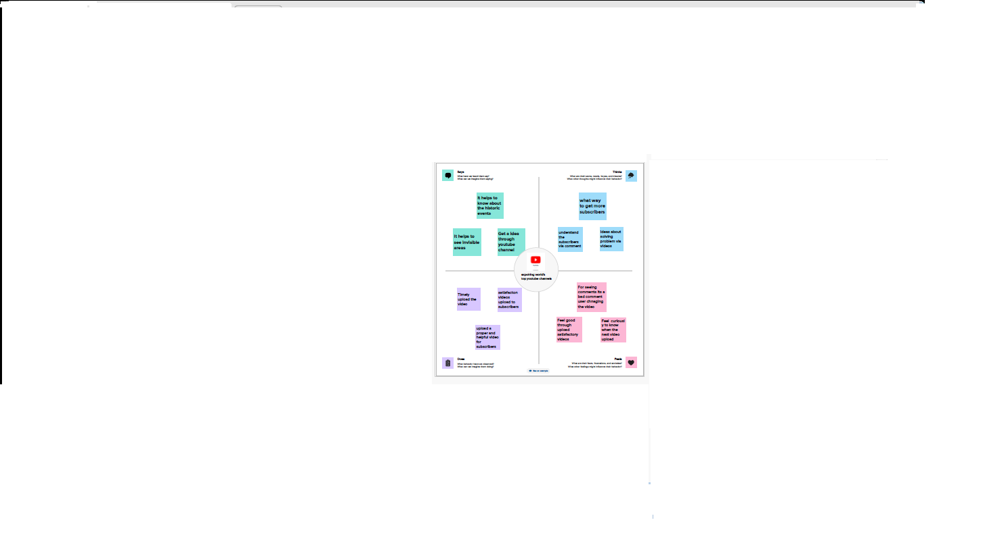
EMPATHY MAP

Slide 5
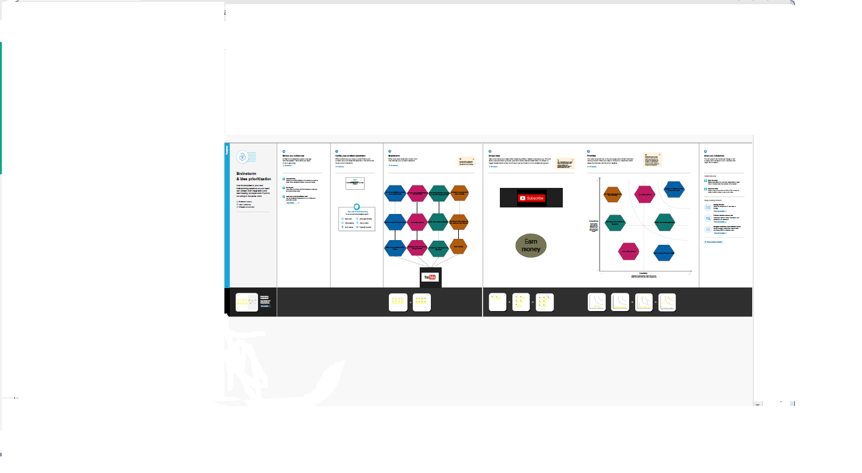
BRAINSTROMING MAP

Slide 6
ADVANTAGE
It provides access to educational content.
YouTube is a great resource for student looking to learn more about a variety of topics.
YouTube is home to many different perspectives and opinions, which can help student better understand a subject from different point views.
Finally, it is super easy to use so any student can figure it.

Slide 7
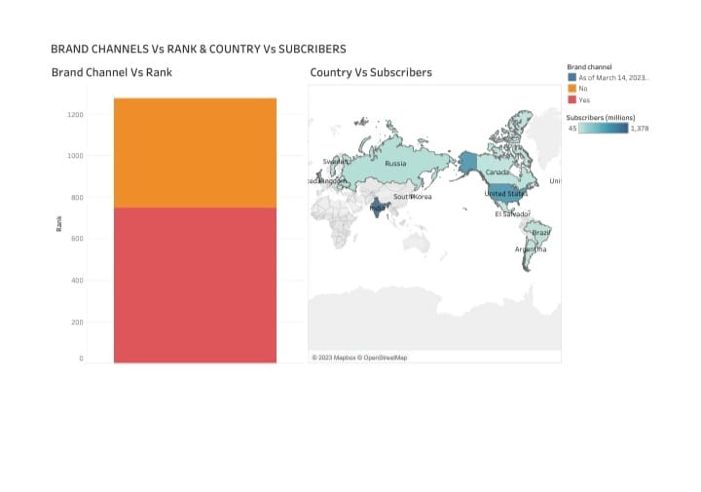
DASHBOARD 1

Slide 8
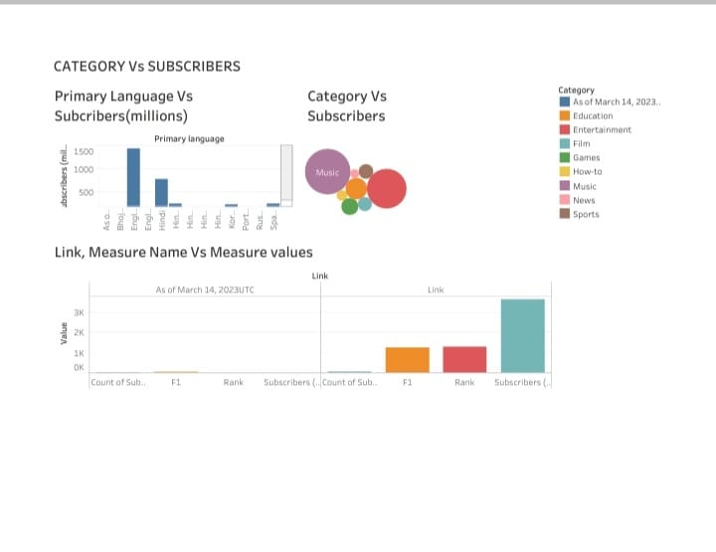
DASHBOARD 2

Slide 9
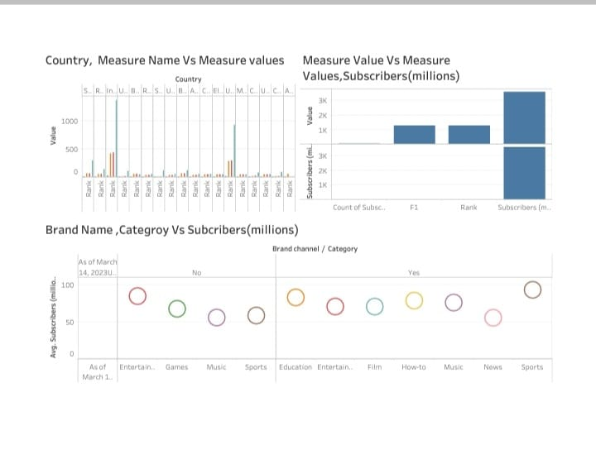
DASHBOARD 3

Slide 10
DISADVANTAGE
Millions of hater comment and troll.
It’s a lot of work, time and stress the pressure is on!
You have to complete with other to stay on top.
It take a little bit of money to make good video and improve.

Slide 11
APPLICATION OF YOUTUBE CHANNEL
YouTube is a video sharing service where user can watch, like, share, comment and upload their own videos.
Doubling down on the streaming and connected TV experience and releasing the creative potential of YouTube in ways that have never been done before.

Slide 12
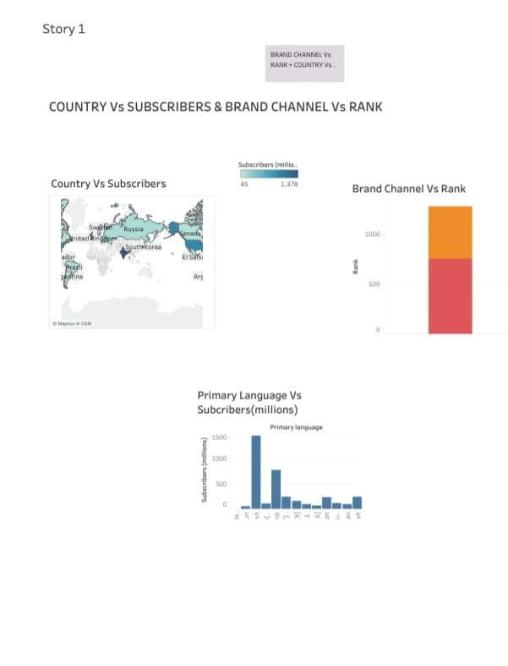
STORY

Slide 13
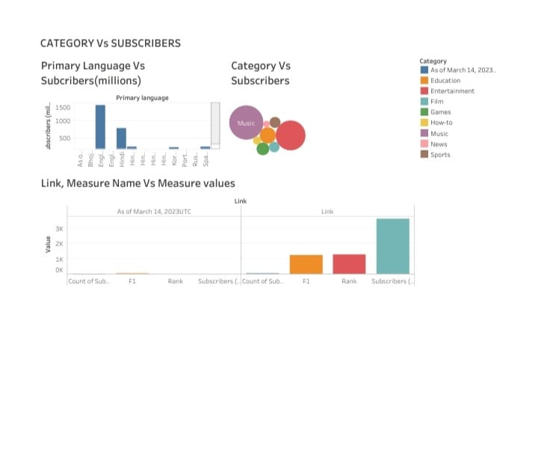

Slide 14
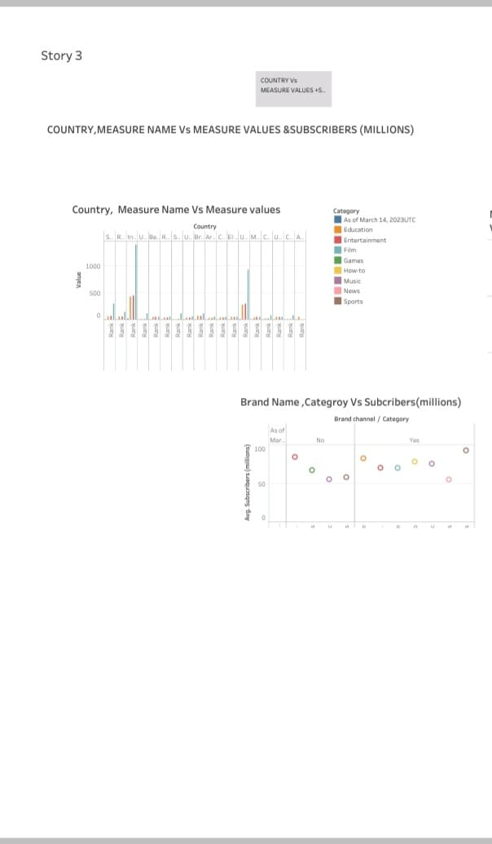

Slide 15
CONCLUSION
YouTube is great place discover new content and connect with other people who share similar interest.
YouTube has just become the most popular video sharing platform.
It provides access to educational content.
Millions of haters comment and trolls.

Slide 16
THANK YOU

